Slide 1
Malware Analysis
Dr. Tran The Son
Vietnam – Korea University

Slide 2
PE Headers and Sections
The PE (Portable Executes) header contains useful information for the malware analyst including
Field | Information revealed
Imports | Functions from other lib. used by the malware
Exports | Functions in the malware called by others
Time Date Stamp | Time complied
Sections | Names of sections in the file and their sizes on the disk and memory
Subsystem | Indicates whether the program is a command-line or GUI app.
Resource | Strings, icons, menus and others included.

Slide 3
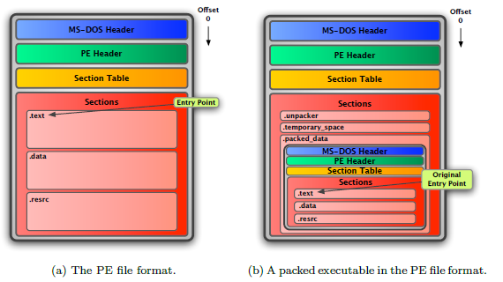
The PE format is based on the Common Object File Format (COFF) used by Unix. The
PE signature is followed by the object file header borrowed from COFF. This header is present also for the object files produced by Microsoft’s
32-bit compilers.
Notes:
Signature is a DWORD(4 bytes) containing the value 50h, 45h, 00h, 00h (“PE” followed by two terminating zeroes).
FileHeader (IMAGE_FILE_HEADER) is the next 20 bytes of the PE file and contains info about the physical layout & properties of the file e.g. number of sections.
OptionalHeader (IMAGE_OPTIONAL_HEADERS) is always present and forms the next 224 bytes. It contains info about the logical layout inside the PE file with fields like AddressOfEntryPoint, ImageBase, FileAlignment, SectionAlignment etc. The last 128 bytes contains the Data Directory which is an array of 16 IMAGE_DATA_DIRECTORY structures.

Slide 4
PE Headers and Sections
.text | Contains program code
.rdata | Holds read-only data that is globally accessible within the program.
.data | Stores global data accessed throughout the program
.idata | Sometimes presents and stores the import function information; if this section is not present, the import function information is stored in the .rdata section.
.edata | Sometimes presents and stores the export function information; if this section is not present, the export function information is stored in the .rdata section.
.pdata | Present only in 64-bit executables and stores exception-handling information.
.rsrc | Stores resources needed by the executable
.reloc | Contains information for relocation of library files

Slide 5
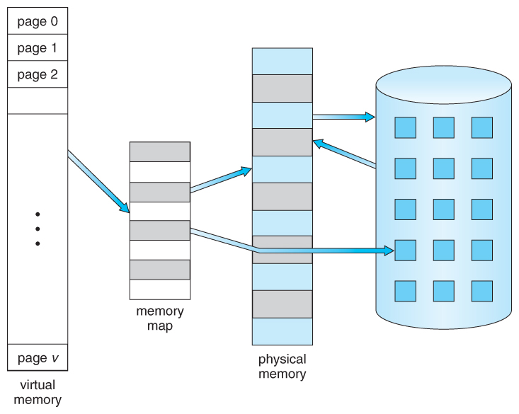
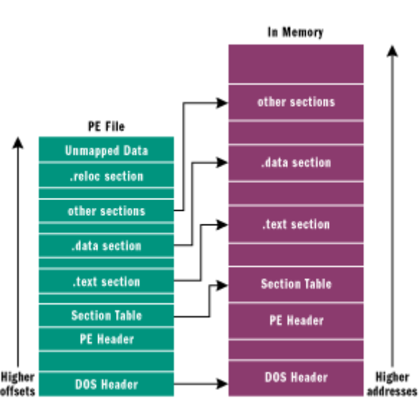
VA vs RVA
An application doesn’t have to occupy a contiguous piece of physical memory; it can be broken down into parts, without the application even needing to know about it.
the Virtual Addresses (VAs) are the memory addresses that are referenced by an application.
An Relative Virtual Address (RVA) is an offset from the base address (ImageBase) at which an executable is loaded in memory
RVA = VA – ImageBase

Slide 6
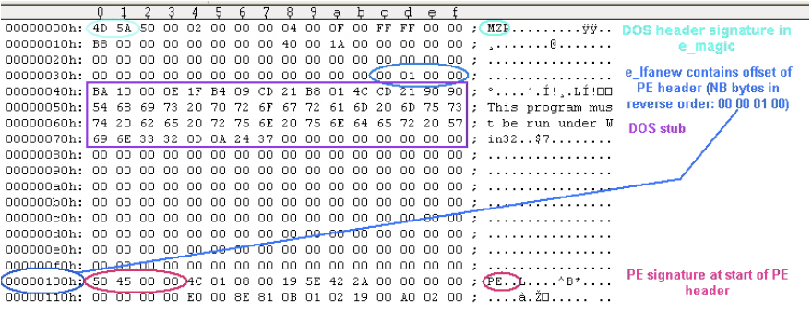
PE header
All later versions of Windows, including Windows 95/98/ME, support the file structure. The format has retained limited legacy support to bridge the gap between DOS-based and NT systems

Slide 7
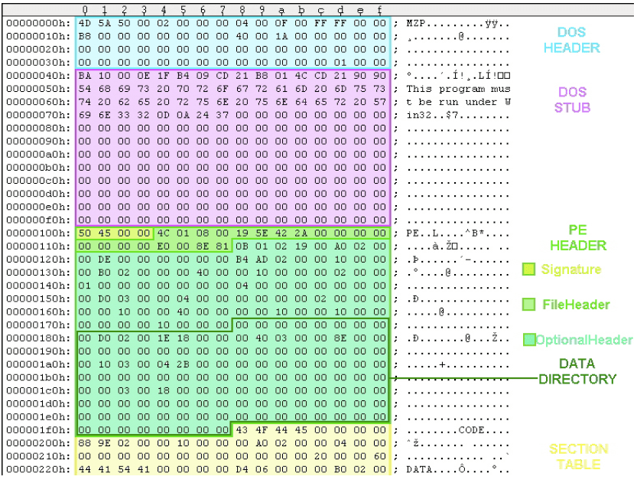

Slide 8
PE header
typedef struct _IMAGE_OPTIONAL_HEADER {
WORD Magic;
BYTE MajorLinkerVersion;
BYTE MinorLinkerVersion;
DWORD SizeOfCode;
DWORD SizeOfInitializedData;
DWORD SizeOfUninitializedData;
DWORD AddressOfEntryPoint;
DWORD BaseOfCode;
DWORD BaseOfData;
DWORD ImageBase;
DWORD SectionAlignment;
DWORD FileAlignment;
WORD MajorOperatingSystemVersion;
WORD MinorOperatingSystemVersion;
WORD MajorImageVersion;
WORD MinorImageVersion;
WORD MajorSubsystemVersion;
WORD MinorSubsystemVersion;
DWORD Win32VersionValue;
DWORD SizeOfImage;
DWORD SizeOfHeaders;
DWORD CheckSum;
WORD Subsystem;
WORD DllCharacteristics;
DWORD SizeOfStackReserve;
DWORD SizeOfStackCommit;
DWORD SizeOfHeapReserve;
DWORD SizeOfHeapCommit;
DWORD LoaderFlags;
DWORD NumberOfRvaAndSizes;
IMAGE_DATA_DIRECTORY DataDirectory[IMAGE_NUMBEROF_DIRECTORY_ENTRIES];
} IMAGE_OPTIONAL_HEADER32, *PIMAGE_OPTIONAL_HEADER32;
OptionalHeader
Magic: 0x010B (32-bit), 0x020B (64-bit).
SizeOfCode: Specifies the total size of executable code.
SizeOfInitializedData: This field holds the size of the initialized data (.data) section, or the sum of all initialized data sections if there are multiple sections.
SizeOfUninitializedData: This field holds the size of the uninitialized data (.bss) section, or the sum of all uninitialized data sections if there are multiple sections.
AddressOfEntryPoint: An RVA of the entry point when the file is loaded into memory.

Slide 9
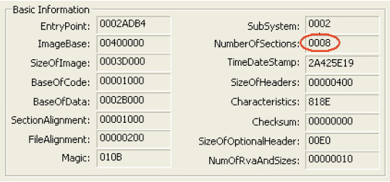
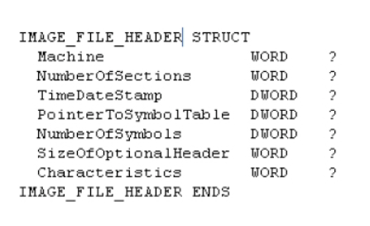
Exercise
Check PE header using HxD/PEView (PEiD): file Lab01-01.exe
Xác định:
  PE header address (Nam)
  EntryPoint Address (Dũng)
  Image Base Address (Huy)
  TimeStamp (Hiếu) DCode
  No. of Sections (Thưởng)
  Magic Value (Khanh)

Slide 10
Bài tập
Khảo sát file PE: Lab03-01.exe
  Địa chỉ bắt đầu của PE header
  Địa chỉ EntryPoint
  Địa chỉ Image Base
  TimeStamp
  No. of Sections
  Magic Value
  Kiến trúc chạy file PE (Machine)

Slide 11
Packing and Obfuscation Techniques
Malware writer often use packing and obfuscation to make their files more difficult to detect or analyse.
  Obfuscated programs: malware writer has attempted to hide.
  Packed programs: a subset of obfuscated programs in which the malicious program is compressed and unable to be analysed.
Packed and obfuscated code will often include at least the functions LoadLibrary and GetProcAddress, which are used to load and gain access to additional functions.

Slide 12
Packing and Obfuscation Techniques
Packing Files
Notes:
Header:
Machine: i386,486,586 (0x14c)

Slide 13
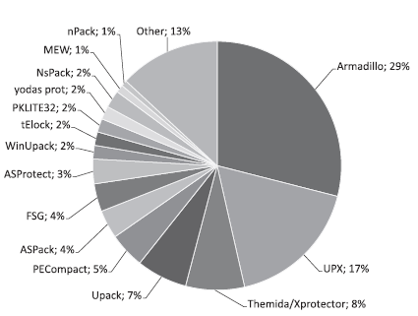
Packing and Obfuscation Techniques
Once a program is packed, it must be unpacked before performing an analysis.
  Detecting packer: PEiD
  Packing/Unpacking: UPX
  Examining header: PEview, Resource Hacker

Slide 14
Unpacking
Find OEP
Dump
Fix IAT
OllyDbg/IDA Pro
Plugin OllyDumpEx
ImportREC

Slide 15
Linked Libraries and Functions
Code libraries can be linked statically, runtime, or dynamically.
Knowing how the library code is linked is critical to our understanding of malware because information that we can find in PE file header depends on how the library code has been linked.
    Static linking: all code of linked library is copied to the executable.
    Dynamic linking: the host OS searches for the necessary libraries when the program is loaded.
    Runtime linking: link to the corresponding library when the function needed.

Slide 16
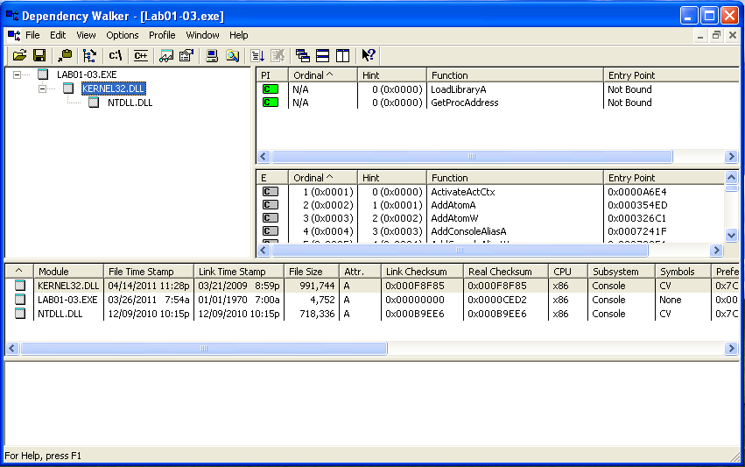
Linked Libraries and Functions
Exploring Dynamically Linked Function with Dependency Walker

Slide 17
Common DLLs
DLL | Description
Kernel32.dll | Chứa các hàm/chức năng là nhân của HĐH như truy cập và thao tác với bộ nhớ, file và phần cứng
Advapi32.dll | Cung cấp chức năng truy cập đến nhân của HĐH (nâng cao) như quản lý dịch vụ và thanh ghi
User32.dll | Chứa các giao diện người dùng như button, thanh cuộn, các tương tác với người dùng
Gdi32.dll | Chứa các hàm hiển thị và xử lý đồ họa
Ntdll.dll | DLL này cho phép giao tiếp với nhân của HĐH. Thường các file thực thi không import trực tiếp thư viện này mà thực hiện gián tiếp thông qua Kernell32.dll. Nếu một c.trình import DLL này thì c.trình đó muốn sử dụng các chức năng không cho phép dùng của Windows như giấu file, hoặc xử lý các tác vụ
WSock32.dll /Ws2_32.dll | Đây là các thư viện liên quan đến chức năng mạng. Một chương trình sử dụng nó có khả năng sẽ tạo kết nối mạng hoặc thực hiện các tác vụ liên quan.
Wininet.dll | Thư viện này chứa các chức năng mạng bậc cao để triển khai các giao thức như FTP, HTTP, NTP.

Slide 18
Strings
A program contains strings if it:
  Print a message
  Connects to a URL
  Copies file to a specific location
Strings (often in ASCII or Unicode) reveals functionalities of a program.

Slide 19
Strings
Null
Terminator
  ASCII
  Unicode
  Tool
    Strings.exe
    PEiD
L
O
V
E
4C
4F
56
45
00
Null
Terminator
L
O
V
E
4C
00
4F
00
56
00
45
00
00
00

Slide 20
Hash Function
Check the integrity of a file
  Unique hash value, fixed length
  Common hash functions: MD-5, SHA-256
Application
  - A Fingerprint (or Signature) for malware
  Share generated hash with other analysts
  Search for generated hash on-line to see if the file has already identified
Tools
    HashCal
    md5deep
Notes:
83c21d49acae2dea242d1b687cf3061b

Slide 21
Practice
Files: Lab01-01.exe (or any malware file)
Identify
  Strings: guess the purpose of the malware
  Hash: (download HashCalc)
    MD5
    SHA-1
    SHA-256
Write a piece of code to
  Detect strings contained in a PE file
  Generate MD-5, SHA-256 code

